Slide 1
POLYNOMIAL LINEAR REGRESSION (TIET, Patiala)

Slide 2
Polynomial linear regression
Simple linear regression and multiple linear regression already discussed.
In both Simple linear regression and multiple linear regression the dependent variable or output variable changes linearly with respect to the independent variable(s).
But, in some cases, the dependent variable may not respond linearly to the independent variable(s) changes.

Slide 3
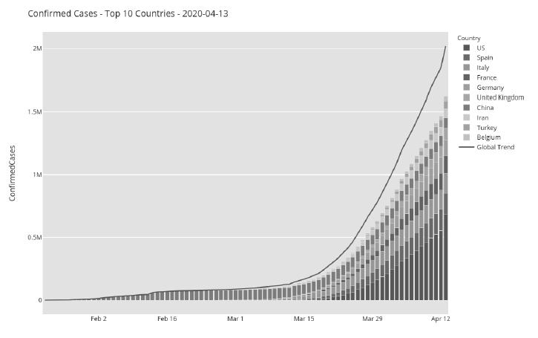
Example: Number of COVID cases increased in polynomial form with each passing day.

Slide 4
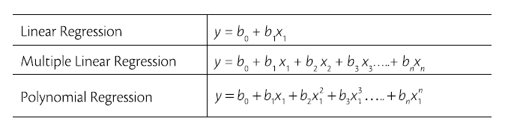
Mathematical representation of different regression model.
In polynomial regression same variable x1 raised to different powers.
In Multiple linear regression, we have different variables (x₁, x₂, x₃, ..) all the linear powers.

Slide 5
In polynomial regression, the relationship between the dependent variable (y) and independent variable (x) is described using a polynomial of n degree.
Why is it called linear?
All the coefficients (b₀, b₁, b₂, ..) are still have the power of 1 and are not raised to any other power.

Slide 6
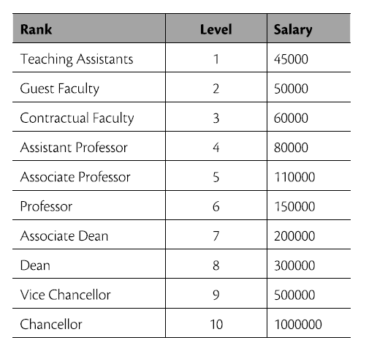
Case Study of Rank-Salary
Inputs:
Different ranks Level is from 1 (min) to 10 (max)
Output:
Salary This is a regression problem because
the model has to predict salary value.

Slide 7
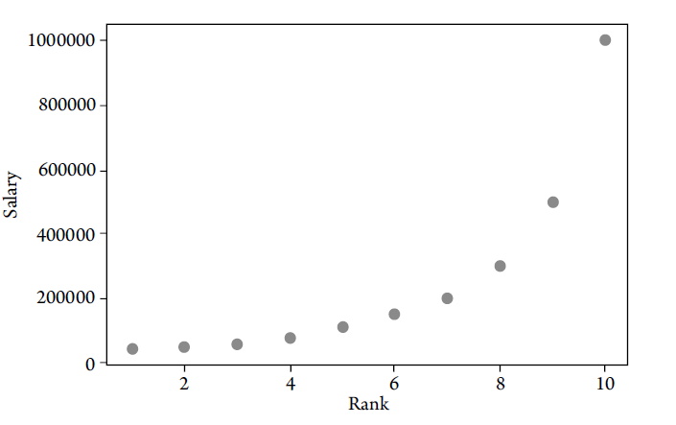
Plot the data points in an XY plane and study the behaviour of the data.
Non-linear nature

Slide 8
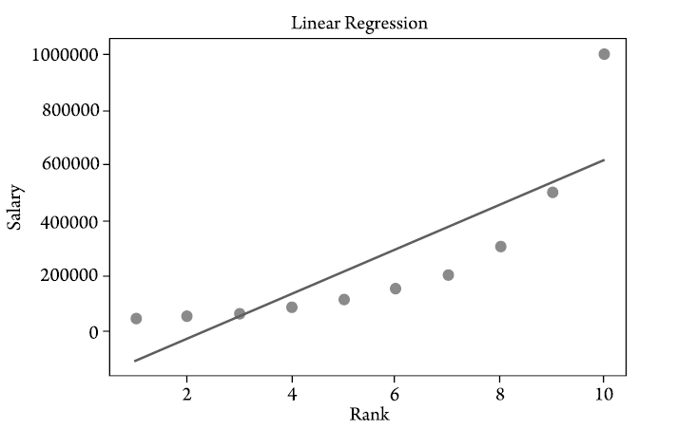
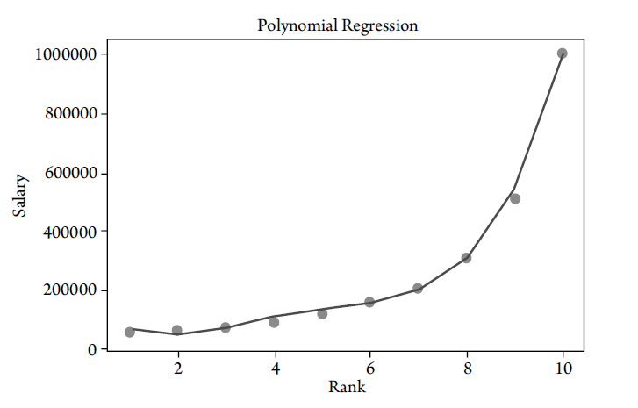
Linear Regression | Polynomial linear regression

Slide 9
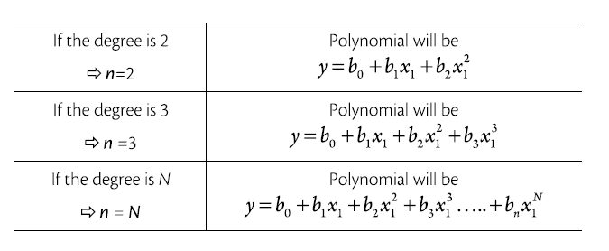
In polynomial linear regression, the degree of independent variable plays an important role in the accuracy of prediction.
We can increase the degree to get the best fit model.
Effect of degree on polynomial equation

Slide 10
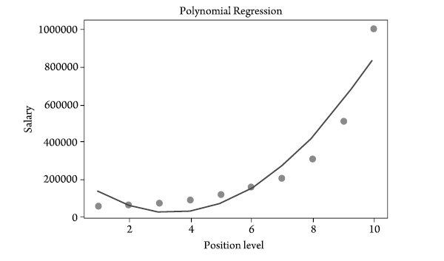
For degree n = 2, the output variable y = b₀ + b₁x₁ + b₂x₁²

Slide 11
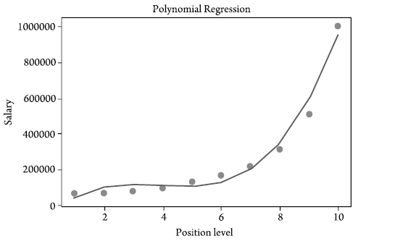
For degree n = 3, the output variable y = b₀ + b₁x₁ + b₂x₁² + b₃x₁³

Slide 12
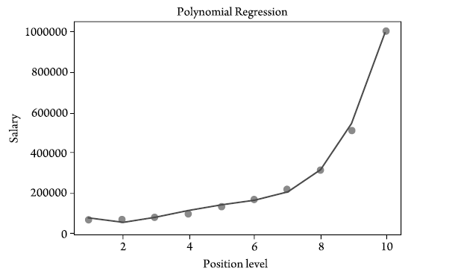
For degree n = 4, the output variable (Best fit-model)
y = b₀ + b₁x₁ + b₂x₁² + b₃x₁³ + b₄x₁⁴

Slide 13
Problem Setup
Goal: Fit a quadratic polynomial to data using least squares.
Model:
y = β₀+β₁x+β₂x²
Coefficients: β₀, β₁, β₂​
Training data: (x_{i}, y_{i}), i =1,2,…,n

Slide 14
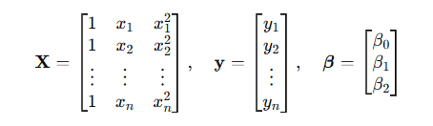
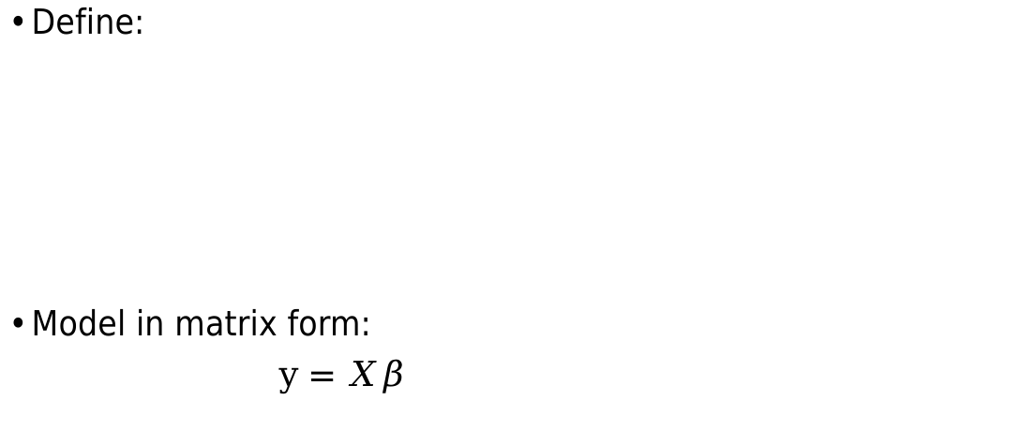
Matrix Representation
Define:
Model in matrix form:
$y=Xβ$

Slide 15
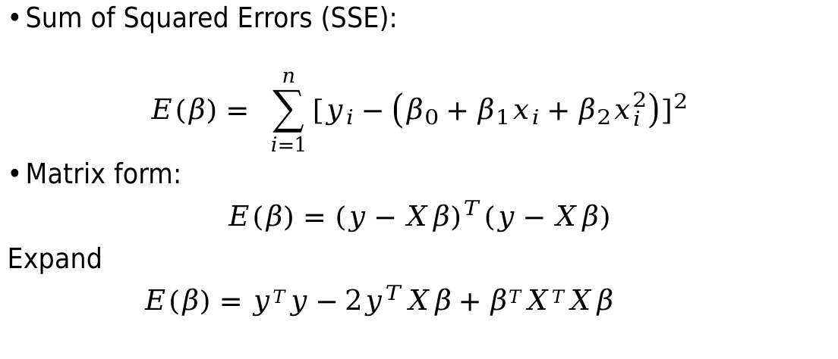
Error (Loss) Function
Sum of Squared Errors (SSE):
$$E\left(β\right)= \sum_{i=1}^{n}{{[y_{i}−\left(β_{0}+β_{1}x_{i}+β_{2}x_{i}^{2}\right)]}^{2}}$$
Matrix form:
$E\left(β\right)=$ ${(y−Xβ)}^{T}(y−Xβ)$
Expand
$E\left(β\right)=$ ${yTy−2y}^{T}Xβ+βTXTXβ$

Slide 16
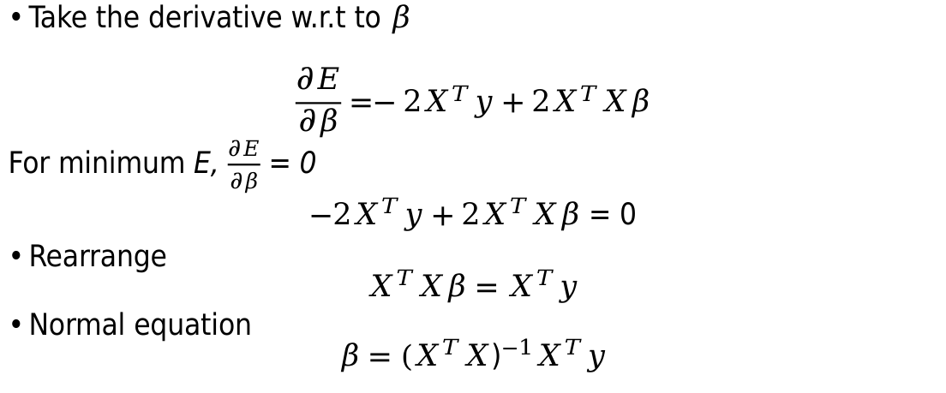
Minimisation
Take the derivative w.r.t to $β$
$$\frac{∂E}{∂β}=−2X^{T}y+2X^{T}Xβ$$
For minimum E, $\frac{∂E}{∂β}$ = 0
$−2X^{T}y+2X^{T}Xβ$ = 0
Rearrange
$$X^{T}Xβ=X^{T}y$$
Normal equation
$$β={(X^{T}X\text{)}}^{−1}X^{T}y$$

Slide 17
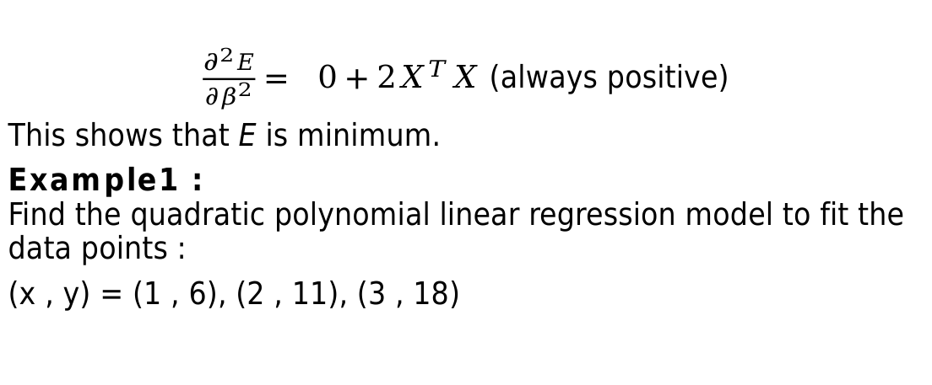
Second derivative test
$\frac{∂^{2}E}{∂β^{2}}= 0+2X^{T}X$ (always positive)
This shows that E is minimum.
Example1 : Find the quadratic polynomial linear regression model to fit the data points :
(x , y) = (1 , 6), (2 , 11), (3 , 18)

Slide 18
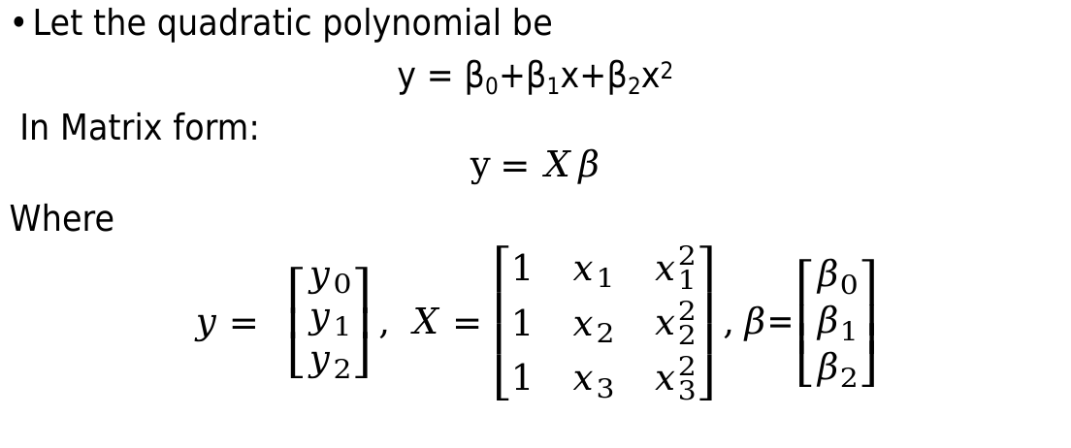
Solution
Let the quadratic polynomial be
y = β₀+β₁x+β₂x²
In Matrix form:
$$y=Xβ$$
Where
$y= \left[\begin{matrix}y_{0} \\ y_{1} \\ y_{2}\end{matrix}\right], X=\left[\begin{matrix}1 & x_{1} & x_{1}^{2} \\ 1 & x_{2} & x_{2}^{2} \\ 1 & x_{3} & x_{3}^{2}\end{matrix}\right],β$=$\left[\begin{matrix}β_{0} \\ β_{1} \\ β_{2}\end{matrix}\right]$

Slide 19
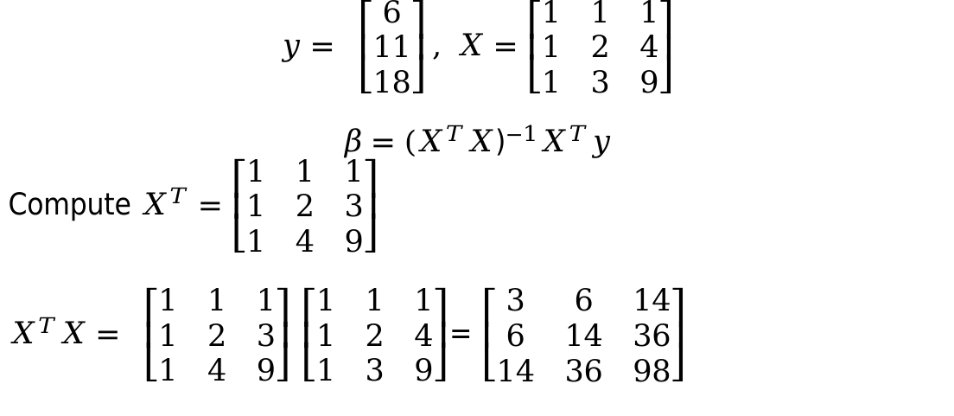
$$y= \left[\begin{matrix}6 \\ 11 \\ 18\end{matrix}\right], X=\left[\begin{matrix}1 & 1 & 1 \\ 1 & 2 & 4 \\ 1 & 3 & 9\end{matrix}\right]$$
$$β={(X^{T}X\text{)}}^{−1}X^{T}y$$
Compute $X^{T}=\left[\begin{matrix}1 & 1 & 1 \\ 1 & 2 & 3 \\ 1 & 4 & 9\end{matrix}\right]$
$X^{T}X= \left[\begin{matrix}1 & 1 & 1 \\ 1 & 2 & 3 \\ 1 & 4 & 9\end{matrix}\right]$ $\left[\begin{matrix}1 & 1 & 1 \\ 1 & 2 & 4 \\ 1 & 3 & 9\end{matrix}\right]$= $\left[\begin{matrix}3 & 6 & 14 \\ 6 & 14 & 36 \\ 14 & 36 & 98\end{matrix}\right]$

Slide 20
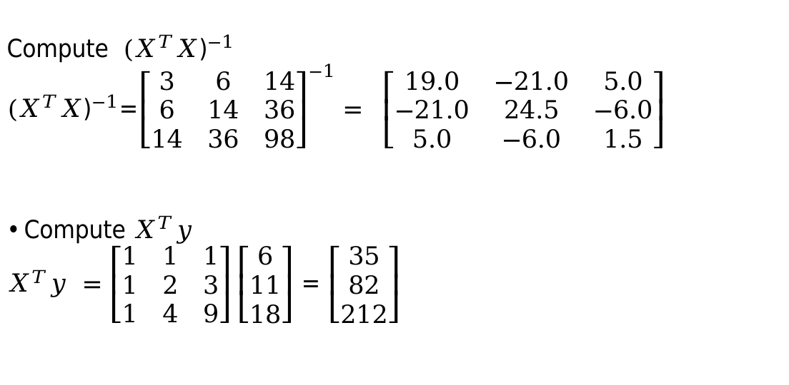
Compute ${(X^{T}X\text{)}}^{−1}$
${(X^{T}X\text{)}}^{−1}$=${\left[\begin{matrix}3 & 6 & 14 \\ 6 & 14 & 36 \\ 14 & 36 & 98\end{matrix}\right]}^{−1}= \left[\begin{matrix}19.0 & −21.0 & 5.0 \\ −21.0 & 24.5 & −6.0 \\ 5.0 & −6.0 & 1.5\end{matrix}\right]$
Compute $X^{T}y$
$X^{T}y =\left[\begin{matrix}1 & 1 & 1 \\ 1 & 2 & 3 \\ 1 & 4 & 9\end{matrix}\right]\left[\begin{matrix}6 \\ 11 \\ 18\end{matrix}\right]$ = $\left[\begin{matrix}35 \\ 82 \\ 212\end{matrix}\right]$

Slide 21
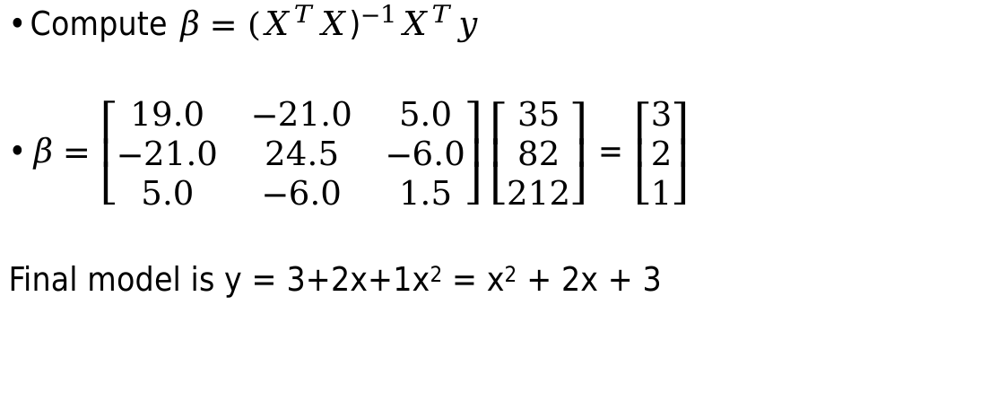
Compute $β={(X^{T}X\text{)}}^{−1}X^{T}y$
$β=\left[\begin{matrix}19.0 & −21.0 & 5.0 \\ −21.0 & 24.5 & −6.0 \\ 5.0 & −6.0 & 1.5\end{matrix}\right]\left[\begin{matrix}35 \\ 82 \\ 212\end{matrix}\right]$ = $\left[\begin{matrix}3 \\ 2 \\ 1\end{matrix}\right]$
Final model is y = 3+2x+1x² = x² + 2x + 3

Slide 22
Example 2:
Find the quadratic polynomial linear regression model to fit the data points :
(x , y) = (3 , 2.5), (4 , 3.2), (5 , 3.8), (6, 6.5), (7, 11.5)
Answer:
y = 12.4285 - 5.5128 x + 0.76428 x²

